Slide 1

CREATE A 32-BIT VEDIC MULTIPLIER AND COMPARE IT AGAINST OTHER MULTIPLIER USING A PARALLEL PREFIX ADDER
A Project Report Submitted for the Award of Bachelor of Technology in Electronics and Communication Engineering
Submitted By:
Sk. Abdul Hameed (22F91A0401) | P. Manohar(22F91A0444) K. Chaithanya (22F91A0413) | Ch. Akash (22F91A0405)
Under the Guidance of: Dr. CH. Ravikumar M.Tech, Ph.D. (Professor & Principal)
Prakasam Engineering College | 2025-2026

Slide 2



Project Overview
The Challenge
The Solution
Modern Digital Signal Processors (DSPs) require high-speed arithmetic operations. Traditional multipliers like Array and Booth suffer from significant propagation delays as bit-width increases, creating a bottleneck in performance.
We propose a hybrid architecture combining ancient Vedic Mathematics (Urdhva Tiryagbhyam sutra) with a modern Parallel Prefix Adder (PPA). This design minimizes carry propagation delay and optimizes the Power-Delay Product (PDP).
Batch 10 - ECE

Slide 3

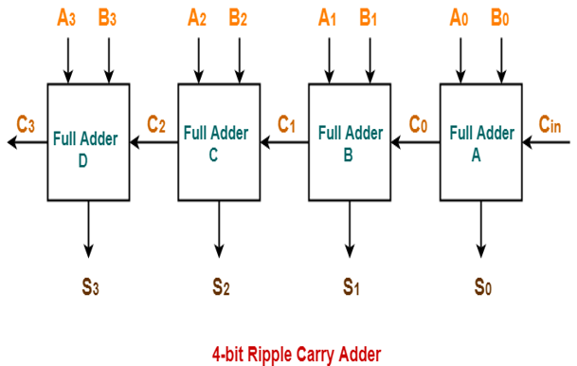
The "Critical Path" Problem
Ripple Carry Adder Limitations
In conventional designs, the adder stage is the bottleneck. A Ripple Carry Adder (RCA) must wait for the carry bit to propagate from the LSB to the MSB.
Linear Delay Complexity: O(N)
High switching activity leads to increased dynamic power consumption.
Becomes unusable for real-time 32-bit or 64-bit processing.
Batch 10 - ECE

Slide 4

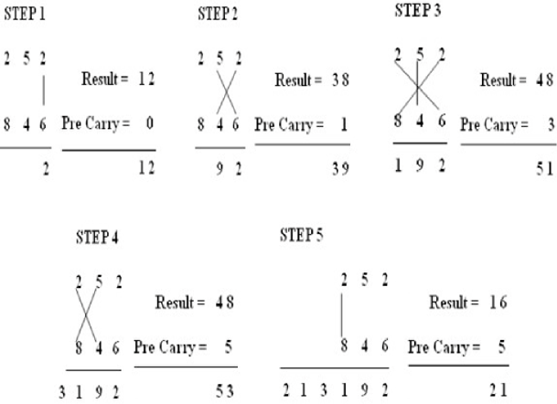
Methodology: Vedic Mathematics
Urdhva Tiryagbhyam Sutra
Meaning "Vertically and Crosswise", this sutra enables parallel generation of partial products.
Parallel Generation: Partial products are generated simultaneously rather than sequentially.
Reduced Logic: Simplifies the hardware requirements compared to complex Booth encoding.
Scalability: Ideally suited for a modular "Divide and Conquer" architecture.
Batch 10 - ECE

Slide 5





Hierarchical Architecture
The 32-bit multiplier is constructed using a bottom-up approach, instantiating smaller blocks to build complex systems.
2x2 Bit Block
Intermediate Blocks
32x32 Bit System
The fundamental building block using basic logic gates (AND/Half-Adder).
4x4, 8x8, and 16x16 bit multipliers constructed by instantiating the lower-order blocks.
The final design integrates four 16x16 modules and uses Parallel Prefix Adders for the final sum.
Batch 10 - ECE

Slide 6
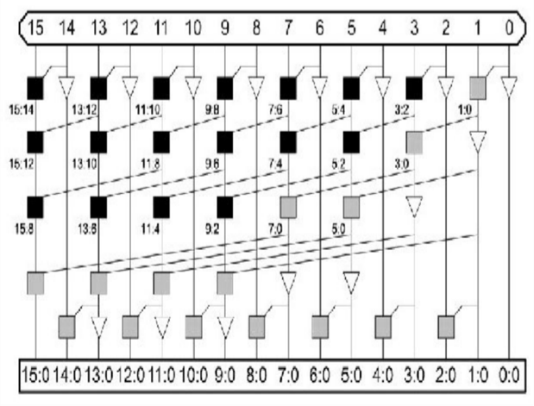
Accelerating Addition with PPA
To solve the carry propagation delay, we replace the RCA with a Parallel Prefix Adder (like Kogge-Stone or Han-Carlson).
PPA computes carry signals in logarithmic time O(log N), essentially "looking ahead" to determine carry status without waiting for the ripple effect. This is crucial for wide bit-width multipliers (32-bit and above).

Slide 7


PPA Processing Stages
1
2
3
Pre-Processing
Carry Generation
Post-Processing
Compute Generate (G) and Propagate (P) signals for each input bit pair.
Compute carries in parallel using the prefix graph network (e.g., Brent-Kung, Kogge-Stone logic). This is the fastest stage.
Calculate the final Sum and Carry-out based on the pre-processed P signals and generated Carries.
Pi = Ai ^ Bi Gi = Ai & Bi
Si = Pi ^ Ci-1
Batch 10 - ECE

Slide 8
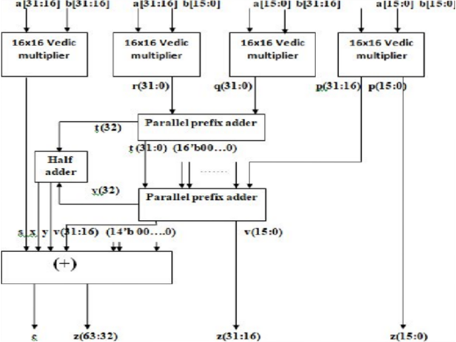
32-Bit Vedic Multiplier Architecture
The architecture diagram illustrates the integration of four 16-bit Vedic multipliers to form the 32-bit system.
Note the placement of the Parallel Prefix Adders (PPA) which take the outputs from the sub-multipliers to generate the final 64-bit product (C63:C0).

Slide 9

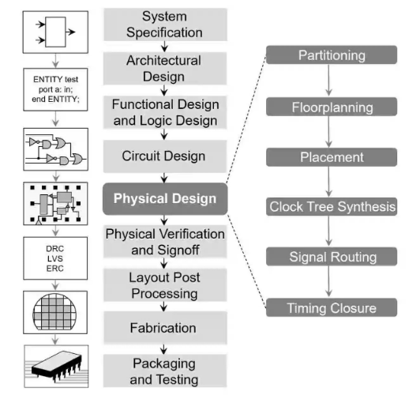
VLSI Design Methodology
We followed a standard ASIC/FPGA design flow to implement the project.
Specification: Defining 32-bit requirements.
RTL Coding: Writing Verilog code for modules.
Functional Verification: Simulation using test benches.
Synthesis: Converting RTL to gate-level netlist.
Implementation: Place & Route on target FPGA.
Batch 10 - ECE

Slide 10


System Implementation
Hardware Description Language
Synthesis & Simulation
Verilog HDL
Xilinx ISE 8.1i / Vivado
Used for behavioral and structural modeling of the Vedic Multiplier and PPA modules. The code is modular and portable.
Used for synthesizing the design, analyzing timing reports, and performing functional simulation (ISim) to verify logic correctness.
Batch 10 - ECE

Slide 11



Verilog Module Hierarchy
Top Module
Sub-Modules
Adder Modules
vedic_32x32.v Inputs: a[31:0], b[31:0] Output: c[63:0]
vedic_16x16.v vedic_8x8.v vedic_4x4.v vedic_2x2.v
hc.v (Han-Carlson PPA) half_adder.v gp.v (Generate/Propagate)
Batch 10 - ECE

Slide 12
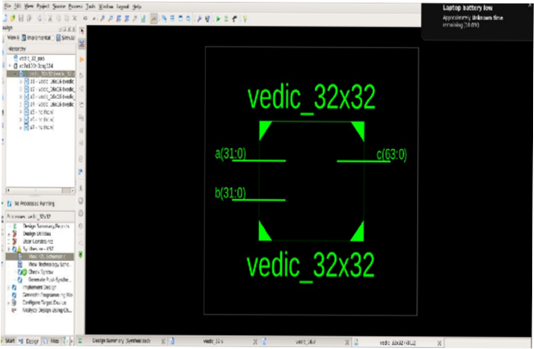
Simulation Results: RTL View
The Register Transfer Level (RTL) schematic confirms the hierarchical structure of the design.
The top-level block vedic_32x32 correctly instantiates four 16-bit multipliers and the necessary adder logic, matching our architectural plan.

Slide 13
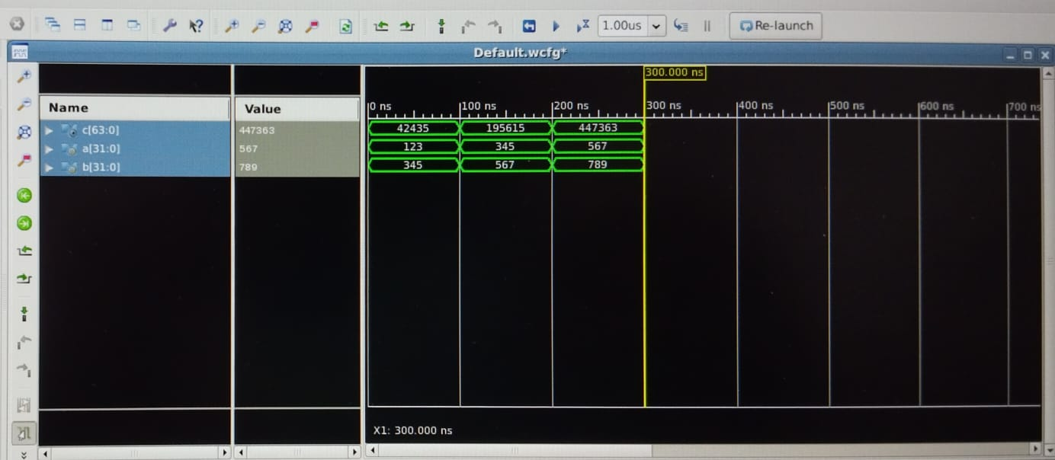
Functional Verification
Simulation waveforms verify the logical correctness of the multiplier.
Test Case: Input A: Valid 32-bit Integer Input B: Valid 32-bit Integer Output C: Correct 64-bit Product
The waveform shows zero latency errors and correct partial product aggregation.

Slide 14
Timing Analysis (Critical Path)
The synthesis report confirms that the Parallel Prefix Adder significantly reduces the path delay compared to standard designs.
21.6
46.2
16%
NANOSECONDS (DELAY)
MHZ (MAX FREQUENCY)
LOGIC DELAY
Batch 10 - ECE

Slide 15
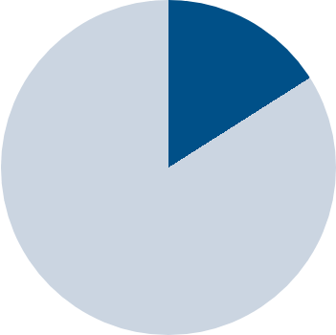
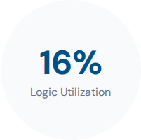
Device Utilization (Area)
Efficient Area Usage
Despite the complexity of PPA, the design maintains a reasonable footprint on the FPGA.
•
Target Device: Spartan-3 / Artix-7
•
Route Delay: ~84% (Due to interconnect complexity)
•
Logic Delay: ~16% (Fast processing)
Batch 10 - ECE

Slide 16
Key Advantages
Power Efficient: Reduced glitching activity compared to Array multipliers.
High Speed: Logarithmic delay reduction using PPA.
Regular Structure: Easier to lay out on silicon compared to Wallace Trees.
Scalability: Easily expandable to 64-bit or 128-bit architectures.
No Encoding Overhead: Faster than Booth's algorithm which requires encoding time.
Throughput: Higher operations per second for DSP applications.
Batch 10 - ECE

Slide 17
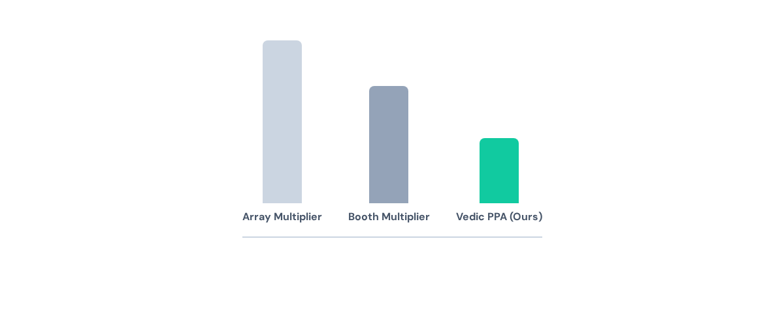
Performance Comparison
Comparison of Propagation Delay (Lower is Better)
Batch 10 - ECE

Slide 18






Real-World Applications
DSP Systems
FFT Algorithms
MAC Units
Cryptography
Digital Signal Processing for filtering and noise reduction.
Multiply-Accumulate units in microprocessors and AI accelerators.
High-speed encryption key generation.
Fast Fourier Transforms requiring massive complex multiplications.
Batch 10 - ECE

Slide 19

"Combining ancient algorithms with modern logic synthesis yields superior performance."
The 32-bit Vedic Multiplier with PPA successfully bridges the gap between speed requirements and area constraints, proving to be an optimal solution for modern VLSI systems.

Slide 20
References
1. Swami Bharati Krishna Tirthaji, "Vedic Mathematics", Motilal Banarsidass Publications, 1965.
4. H. D. Tiwari et al., "Multiplier design based on ancient Indian Vedic Mathematics", ISOCC 2008.
2. Neil H. E. Weste, "CMOS VLSI Design: A Circuits and Systems Perspective".
5. P. M. Kogge and H. S. Stone, "A Parallel Algorithm for the Efficient Solution of a General Class of Recurrence Equations", 1973.
3. Samir Palnitkar, "Verilog HDL: A Guide to Digital Design and Synthesis".
Batch 10 - ECE

Slide 21
THANK YOU

